Slide 1
STAR
Samsung Technology for ARtificial intelligence

Slide 2
What is STAR?
Set of APIs helps you to make it easy and fast to develop AI applications

Slide 3
Vision
Speech
Language
Data
Machine Learning
On-Device FW

Slide 4


Face Detection
Face Identification
Face Verification
Emotion Recognition
Driver’s Status Monitoring
Gaze Following
Product Recognition
2D Object Detection
3D Road Object Detection
Vision
Grocery Recognition
Scene Text Recognition
Scene Description
Others
3D Hand Pose Estimation
Cavity Filter Tuning Automation
Visual Inspection
Road Scene Segmentation

Slide 5
Vision
Source: Medium.com

Slide 6
Automatic Speech Recognition
Speaker Verification & Identification
Speech
E2E Neural TTS
Far-field Speech Enhancement

Slide 7
Speech

Slide 8
Neural Machine Translation
News QA (Korean)
Language
Customer Care
Chatbot Platform (Chatti)

Slide 9

Language

Slide 10
Anomaly Detection
Data Curation
Data
Auto DA

Slide 11
Data

Slide 12
MDC (Matrix Decomposition-based Compression)
Hyperparameter Optimisation
Machine Learning

Slide 13
Machine Learning

Slide 14
NN Runtime
NN Streamer
On-Device FW

Slide 15
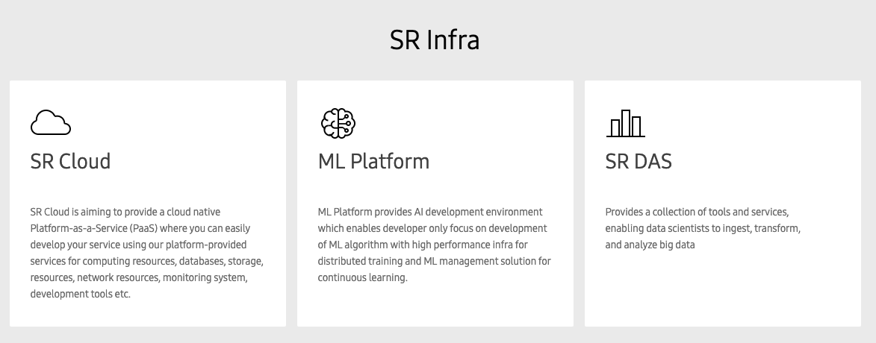

Slide 16
// thank you //

